Slide 1
Smart Grid Vulnerability Analysis Methods
Nyffeler, Lehman, Ward
w

Slide 2
Introduction
Our Team
Wyatt Ward, Project Leader
Andrew Nyffeler
Mitchell Lehman
a

Slide 3
Goals
Find what vulnerabilities exist within smart grid systems
Primary stakeholders: The Purdue Fort Wayne Computer Science Department

Slide 4

Consider, if you Will…
Power interruptions can cripple…
Payment processors
Students submitting homework at the last minute
Sewage pumps
Medical equipment
Significant portions of infrastructure for extended periods
Cellular networks (911 calls)
a

Slide 5






Definitions
A smart grid is a computerized power grid.
In the event of a malfunctioning unit (generator or transformer), power can be automatically redirected from elsewhere.
Transformer
Generator
Consumer
m
Notes:
Power Plant: https://www.kissclipart.com/factory-clipart-car-citron-factory-vvucrf/
Transformer: https://www.vippng.com/preview/ihxJJRR_distribution-transformer-electrical-steel-electrical-transformer-transformer-icon/
PFW: https://pfw.photoshelter.com/galleries/invited_galleries/C0000FUIbLB60jMk/C0000li9qCfTuVD0/C0000pVy0Bv0b1tw/C00005m_PfwyMB3w/C0000QADZPeyIyt8/G0000Kl4b_HiQrB0/Full-Color

Slide 6

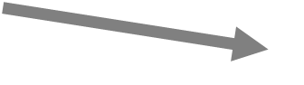
Definitions
A smart grid is a computerized power grid.
In the event of a malfunctioning unit (generator or transformer), power can be automatically redirected from elsewhere.
Transformer
Generator
Consumer
m

Slide 7
w
Notes:
Cascading failure

Slide 8
w

Slide 9
Background Information
Smart grids can be vulnerable to attacks.
If key points are forced offline, the failures can “cascade.”
Cascade happens when the remaining infrastructure fails to meet the burden being placed on it and components begin to fail.
a

Slide 10



Cascade: an Example
Observe how the marked transformer fails in this scenario:
Transformer
8
Max
Load 1
3
1
Generator
Total
1
1
m

Slide 11

Cascade: an Example
A failure elsewhere cause power to be redirected to the transformer
Transformer
8
Max
Load 1
+ 1
3
1
Generator
Total
1
1
m

Slide 12

Cascade: an Example
The redirection overloads the transformer
Transformer
8
Max
Load 1
+ 1
2
3
1
Generator
Total
1
1
m

Slide 13
Cascade: an Example
The overloaded transformer fails, causing a domino effect that cascades
Transformer
8
Max
3
1
Generator
Total
1
1
m

Slide 14
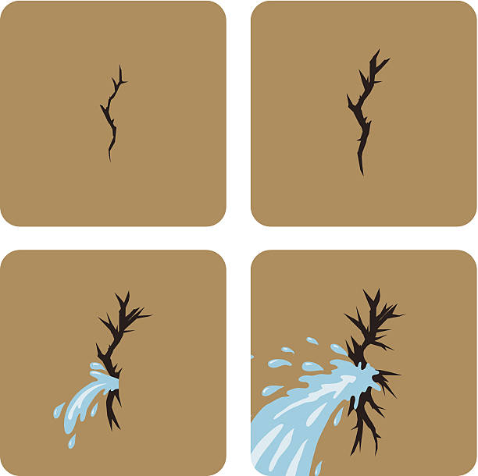
Question
How can we determine the cascading failure point of a system?
w
Notes:
Crack: https://www.istockphoto.com/jp/ベクター/クラックにダム-gm486894653-38938542

Slide 15
Research Problem
We are researching new ways to determine the most likely points of attack on a given grid.
w

Slide 16


What Can We Do?
We must think like the attacker.
w

Slide 17

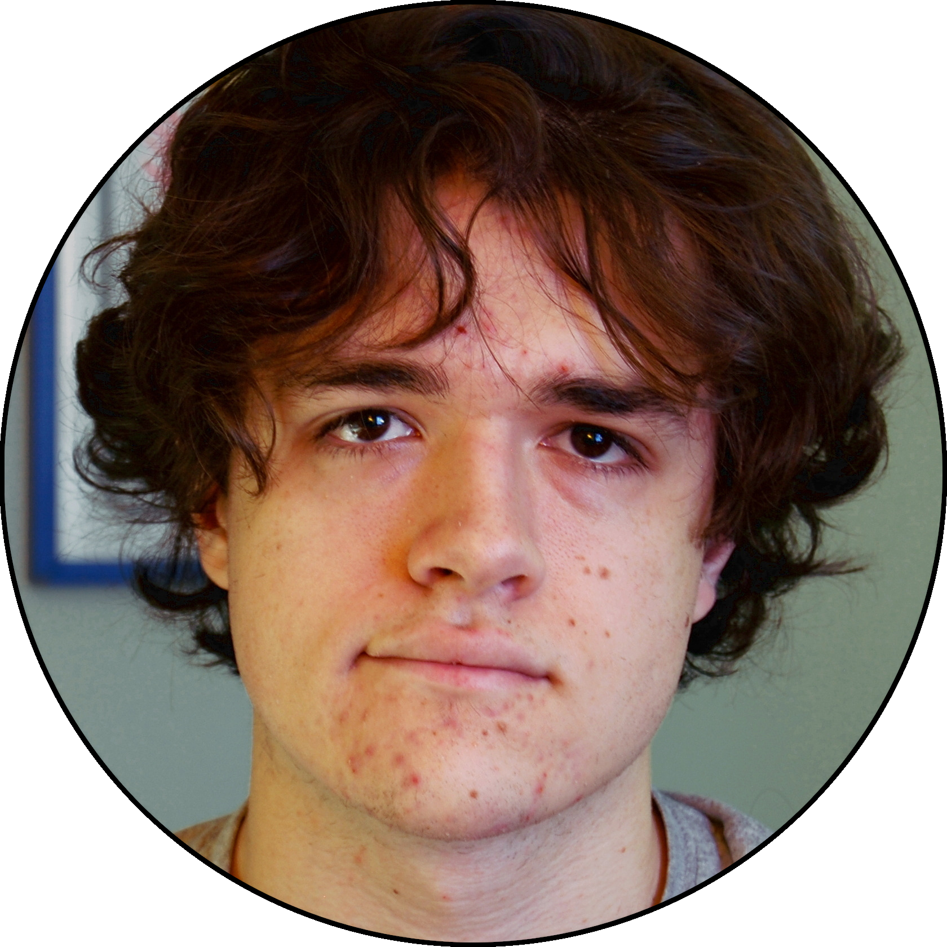
Thinking Like an Attacker
Attackers have finite time/money.
Their attacks need to count.
University
Hospital
Individual
w
Notes:
Minnow and whale for importance? (use animation/pictures)

Slide 18
Priorities
The hospital and university are more attractive targets, and a better use of money and time.
University
Hospital
Individual
w
Notes:
Minnow and whale for importance? (use animation/pictures)

Slide 19
Priorities
If there’s still time and money left over, then moving to a lesser target is still okay.
University
Hospital
Individual
w
Notes:
Minnow and whale for importance? (use animation/pictures)

Slide 20
Thinking Like an Attacker
Everything attackers do has a cost.
Systems that can harden locations from attacks frequently have large costs
Thus, not every location will have the same level of protection
Some may have any protection at all
The level of protection afforded to a location is frequently proportional to the attractiveness of disabling that location
a
Notes:
Minnow and whale for importance? (use animation/pictures)

Slide 21


Factors
What aspects of the Smart Grid system should we worry about?
a
Notes:
Red Question Mark: https://clipartix.com/questions-clipart-image-29220/
Black Pair: https://veritasdomain.files.wordpress.com/2016/02/question-mark-blackandwhite.png

Slide 22
System Model: What’s Important?
With how attackers think in mind, a system model was developed.
The tradeoff: How can our system model be simplified while staying applicable to the real world?
m

Slide 23
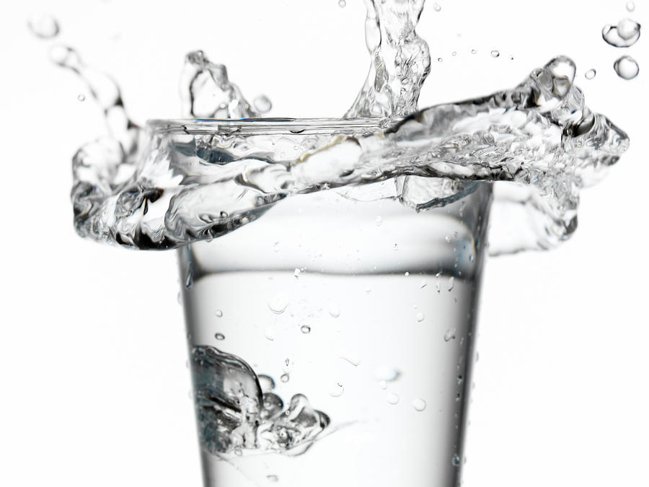
Capacity
There is a limit to the amount of electricity that a transformer can handle.
Parts can only be made to work so hard before they fail.
a
Notes:
Cup: https://fineartamerica.com/featured/1-water-overflowing-cup-zing-images.html

Slide 24
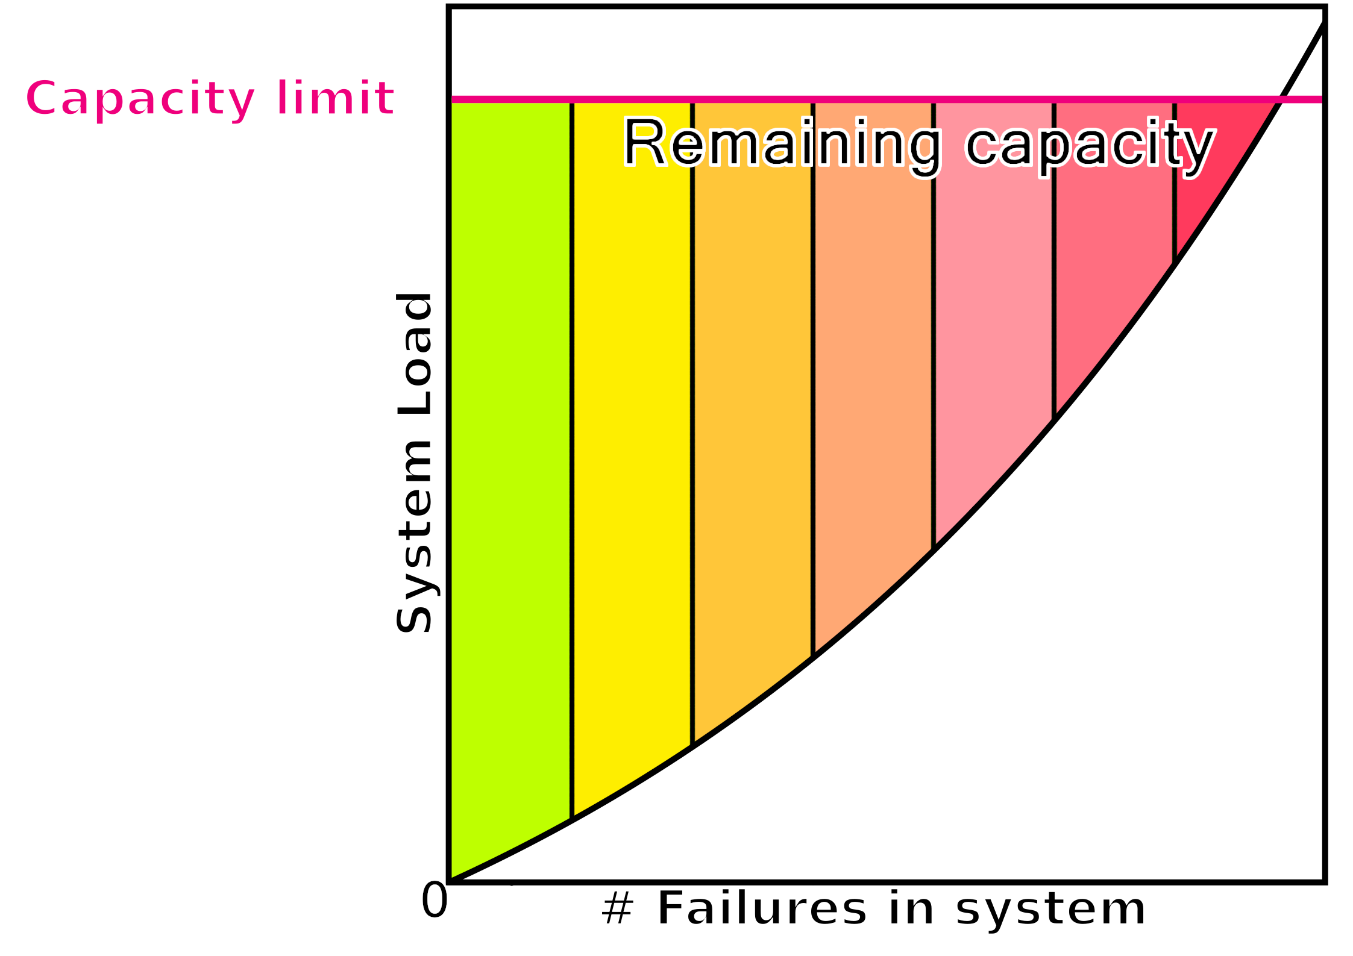
Capacity
Our idea: as parts fail, the remaining parts have to work harder.
a
Notes:
Homemade graph, Wyatt Ward.
I think I need to re-label the axes?

Slide 25



Weight
Not all attack points are as “valuable”
For example, individual houses are not as important as hospitals.
Supports one family
Supports entire communities
a
Notes:
Weight: http://www.clker.com/clipart-weight.html
Hospital: http://cliparts.co/clipart/2332315

Slide 26

Cost
Attacking a transformer requires spending resources
Attackers have a finite resource budget to work with
a
Notes:
Money pile: https://pixabay.com/vectors/cash-finance-financial-green-ideas-1296584/

Slide 27

System Model
Our system consists of Suppliers, Transformers, and power lines.
Transformers:
Weight (W)
Capacity
Cost (C)
(Often linked to capacity)
w
Notes:
Weight: value of customer,
MAIN IDEA: Minimize resources while maximizing cost

Slide 28


Proof of Concept
13/16
1/2
1/2
1/2
W=2
1/2
W=2
C=4
W=4
C=5
4/5
2/3
2/2
1/2
1/2
2/4
1/2
W=2
C=1
W=1
C=1
$$M_{x}=\frac{W_{x}}{C_{x}}$$
2/4
2/2
W=2
C=4
w

Slide 29
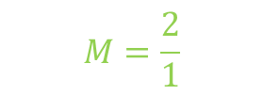
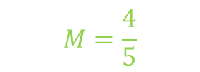
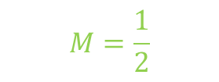
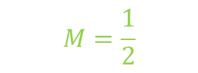
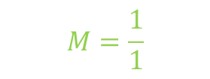
Proof of Concept
13/16
1/2
1/2
1/2
W=2
$$M=\frac{1}{2}$$
1/2
W=2
C=4
W=4
C=5
4/5
2/3
$$M=\frac{4}{5}$$
2/2
1/2
1/2
2/4
1/2
W=2
C=1
W=1
C=1
$$M=\frac{1}{2}$$
$$M=\frac{2}{1}$$
$$M_{x}=\frac{W_{x}}{C_{x}}$$
$$M=\frac{1}{1}$$
2/4
2/2
W=2
C=4
w

Slide 30
Proof of Concept
15/16
2/2
2/2
1/2
W=2
2/2
W=2
W=4
(2+2)
5/5
4/3
2/2
1/2
3/2
2/4
1/2
W=1
W=2
$$M=\frac{2}{1}$$
$$M_{x}=\frac{W_{x}}{C_{x}}$$
4/4
2/2
W=1
w

Slide 31
Proof of Concept
15/16
2/2
0/2
0/2
W=2
0/2
W=2
W=4
(2+2)
4/5
4/3
2/2
2/2
3/2
2/4
0/2
W=1
W=2
$$M_{x}=\frac{W_{x}}{C_{x}}$$
0/4
2/2
W=1
w

Slide 32
Proof of Concept
15/16
2/2
0/2
0/2
W=2
0/2
W=2
W=4
(2+2)
4/5
4/3
2/2
2/2
3/2
2/4
0/2
W=1
W=2
$$M_{x}=\frac{W_{x}}{C_{x}}$$
0/4
2/2
W=1
w

Slide 33
Proof of Concept
15/16
2/2
0/2
0/2
W=2
0/2
W=2
W=4
(2+2)
4/5
4/3
2/2
2/2
3/2
2/4
0/2
W=1
W=2
$$M_{x}=\frac{W_{x}}{C_{x}}$$
0/4
2/2
W=1
w

Slide 34
Future Possibilities
Automate it!
Add more factors to make a more detailed model (capacitance, inductance)
m

Slide 35
Project Schedule
Our group primarily focused on meeting twice a week to discuss what we currently had done, what we were going to do, and what we needed to do later.
This system worked well until physical classes were cancelled. After that, we did our best to meet as often as possible remotely via software such as Zoom.

Slide 36
Looking Back
Hours Worked:
Our group managed to put in nearly 350 hours over the course of both semesters

Slide 37
Looking Back
Positive Outcomes:
Got more experience working together as a group towards a common goal
Gained insight into the world of computer science academia while doing research
Learned how to work with more freedom and more broad guidance

Slide 38
Looking Back
Difficulties Faced:
Staying on track, especially in the beginning when our plan was not as well thought out as it was later
Meeting regularly and routine communication became much more difficult when we could no longer meet physically

Slide 39
Looking Back
What could we have done differently?
Spend more time doing work individually
Allocate the project more efficiently between group members
Choose a project with more concrete goals from the beginning

Slide 40
Image Sources
https://www.kissclipart.com/factory-clipart-car-citron-factory-vvucrf/
https://www.vippng.com/preview/ihxJJRR_distribution-transformer-electrical-steel-electrical-transformer-transformer-icon/
https://pfw.photoshelter.com/galleries/invited_galleries/C0000FUIbLB60jMk/C0000li9qCfTuVD0/C0000pVy0Bv0b1tw/C00005m_PfwyMB3w/C0000QADZPeyIyt8/G0000Kl4b_HiQrB0/Full-Color
http://www.clker.com/clipart-weight.html
https://fineartamerica.com/featured/1-water-overflowing-cup-zing-images.html
https://pixabay.com/vectors/cash-finance-financial-green-ideas-1296584/
https://veritasdomain.files.wordpress.com/2016/02/question-mark-blackandwhite.png
https://clipartix.com/questions-clipart-image-29220/
http://www.clker.com/clipart-orange-house-2.html
http://cliparts.co/clipart/2332315
https://picsart.com/i/sticker-304848469029211
http://www.clker.com/cliparts/r/K/T/F/J/l/cartoon-thought-bubble-md.png
https://www.istockphoto.com/jp/ベクター/クラックにダム-gm486894653-38938542

